Slide 1

Using Machine Learning for Customer Segmentation
A market study for developing business in the wine industry.

Slide 2
Design
Geo-location data available for nearly every winery and vineyard on the planet.
Rich API content from FourSquare.
Clustering using unsupervised machine learning DBSCAN.

Slide 3
Application
Market development for new territories.
API calls for dataset from FourSquare.
Geolocation Data is provided.
Incorporate Client Data

Slide 4
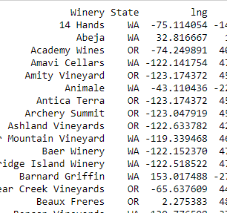
Client Data
List of client wineries from data center.
Geolocation and Mapping
Data needs cleaning.

Slide 5
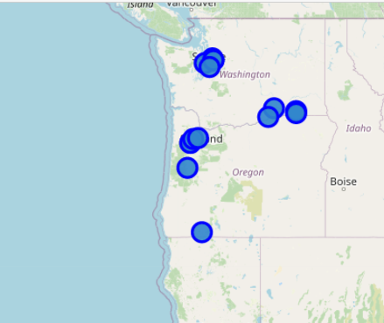
Client List
Client list retrieved from Data World.
Using Folium and Geopy

Slide 6
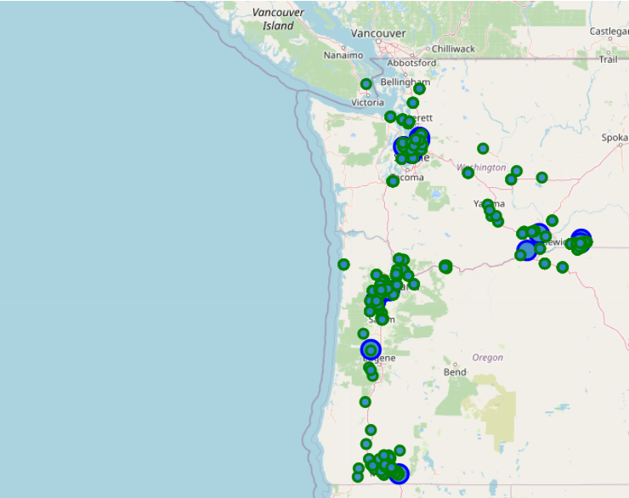
API Search Call for Neighbors
All wineries and vineyard locations located within 100km.
Feature rich results.
Explore vast neighborhoods with real time user data.

Slide 7
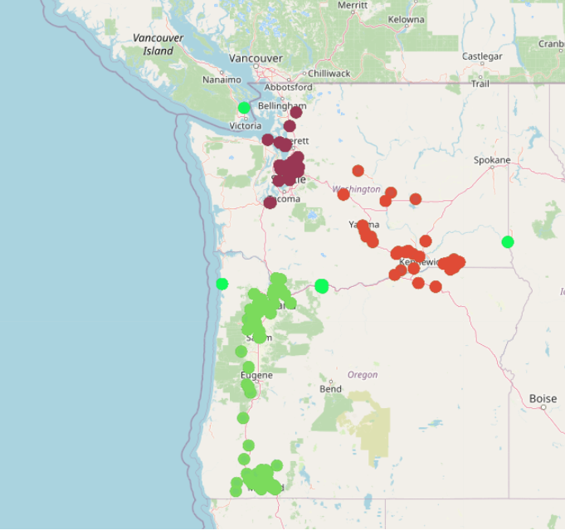
DBSCAN
Kms/Rad: 6371.0088
Epsilon: 65 / kms_per_radian
Min-Samples: 5
Haversine metric

Slide 8
Conclusions
Potential client database is deep and vast.
Insight is provided into market using machine learning.
Functional approaches to territory development are elucidated using market penetration studies such as this one.

